Slide 1

Effective Marketing Strategy for New Product Launch
Key elements for a successful product introduction
Notes:
AI-generated content may be incorrect. --- Launching a new product requires a well-thought-out marketing strategy that aligns with business goals. This presentation will explore the essential components of a marketing strategy tailored for a successful product launch.

Slide 2
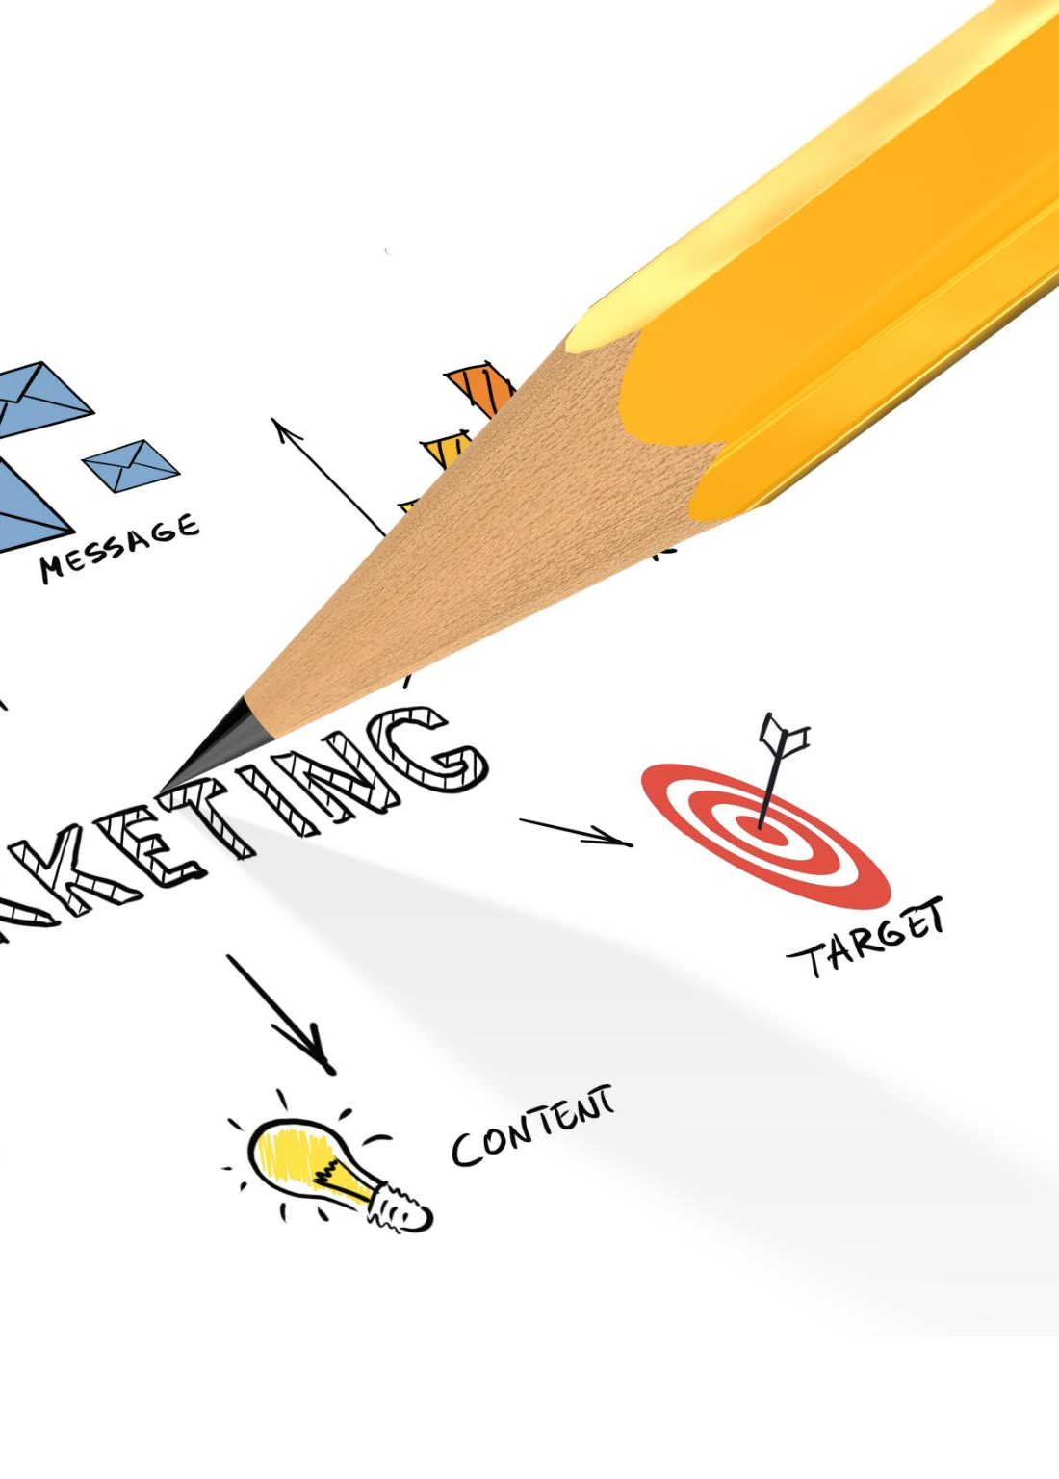
Presentation Overview
Introduction to Marketing Strategy
We will begin with an overview of what a marketing strategy entails and its importance in product launches.
Market Understanding
Analyzing the market landscape to identify opportunities and challenges is crucial for effective marketing.
Target Audience Identification
Identifying and understanding the target audience is essential for tailoring marketing messages and campaigns.
Marketing Mix
Exploring the marketing mix (4Ps) helps in creating a balanced approach to reach the audience effectively.
Measuring Success
We will conclude with methods to measure the success of the marketing strategy and product launch.
Notes:
In this presentation, we will cover the key aspects of a marketing strategy for a new product launch. We will start with an introduction to marketing strategy, followed by market understanding, target audience identification, the marketing mix, and finally, how to measure success.

Slide 3
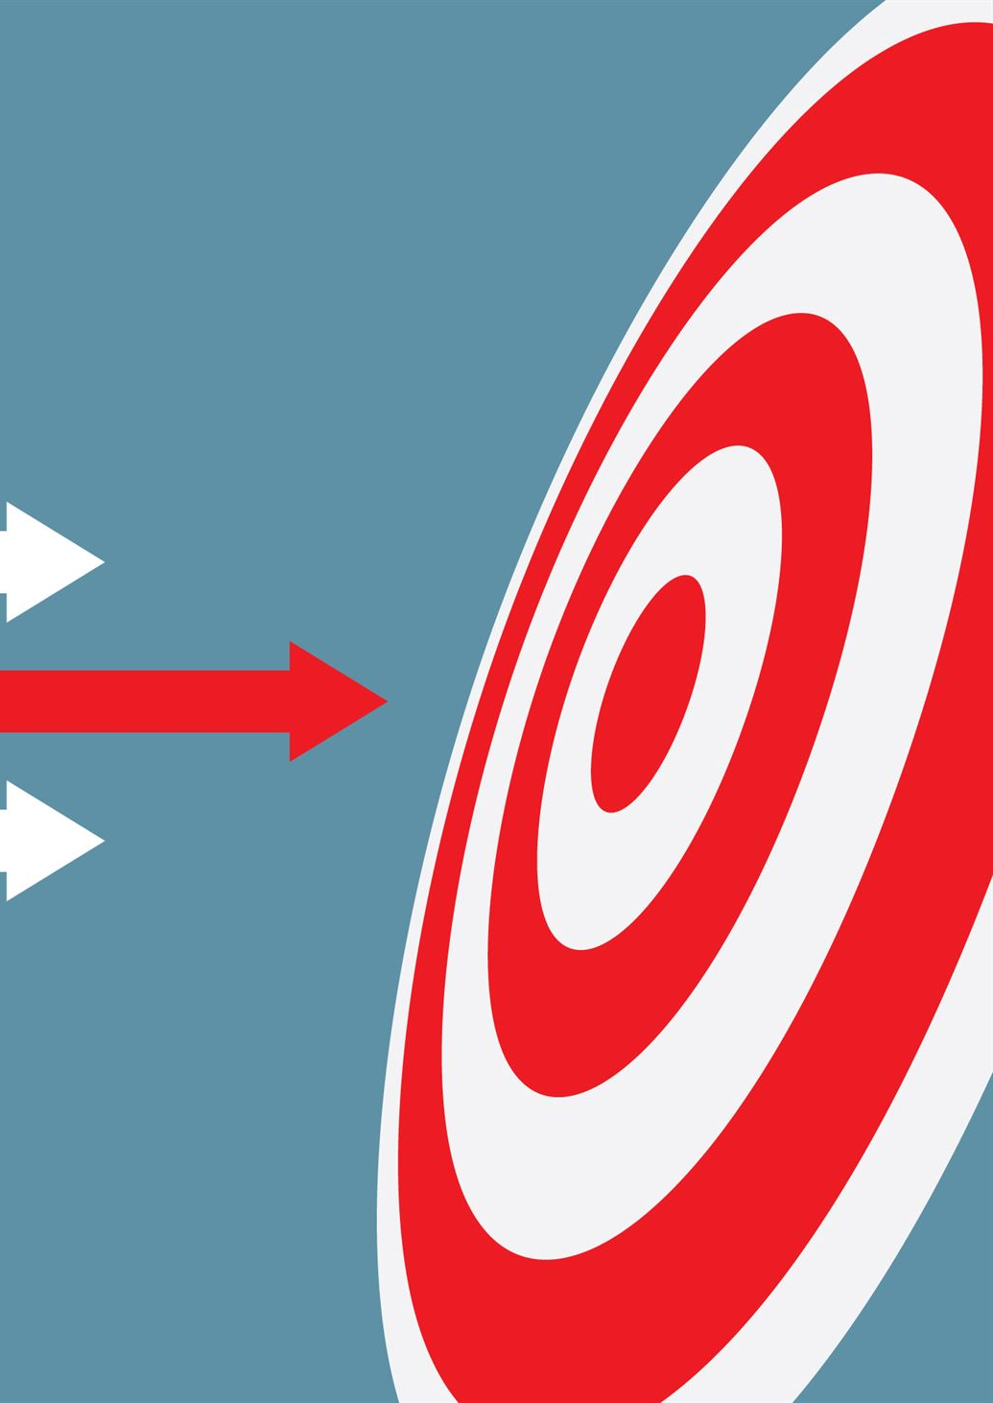
Introduction to Marketing Strategy
Attracting Customers
A successful marketing strategy focuses on attracting customers through targeted campaigns and effective messaging that resonates with the audience.
Customer Retention
Retaining customers is crucial; strategies must focus on building relationships and ensuring customer satisfaction for long-term loyalty.
Unique Selling Proposition
Defining a product's unique selling proposition helps differentiate it in the market, making it appealing to potential customers.
Establishing Goals
Setting clear, measurable goals for the launch process is essential to guide the marketing strategy and track its success.
Notes:
A marketing strategy outlines how a company will attract and retain customers. It includes defining the product’s unique selling proposition and establishing goals for the launch process.

Slide 4

What is a Marketing Strategy?
Comprehensive Planning
A marketing strategy outlines a detailed plan to meet specific marketing objectives, ensuring all efforts are aligned.
Understanding Market Landscape
It involves analyzing the market landscape to identify trends, competition, and customer needs effectively.
Targeting Potential Customers
The strategy determines the best approaches to reach potential customers through various channels and methods.
Notes:
A marketing strategy is a comprehensive plan formulated particularly for achieving marketing objectives. It involves understanding the market landscape and determining the best approaches to reach potential customers.

Slide 5
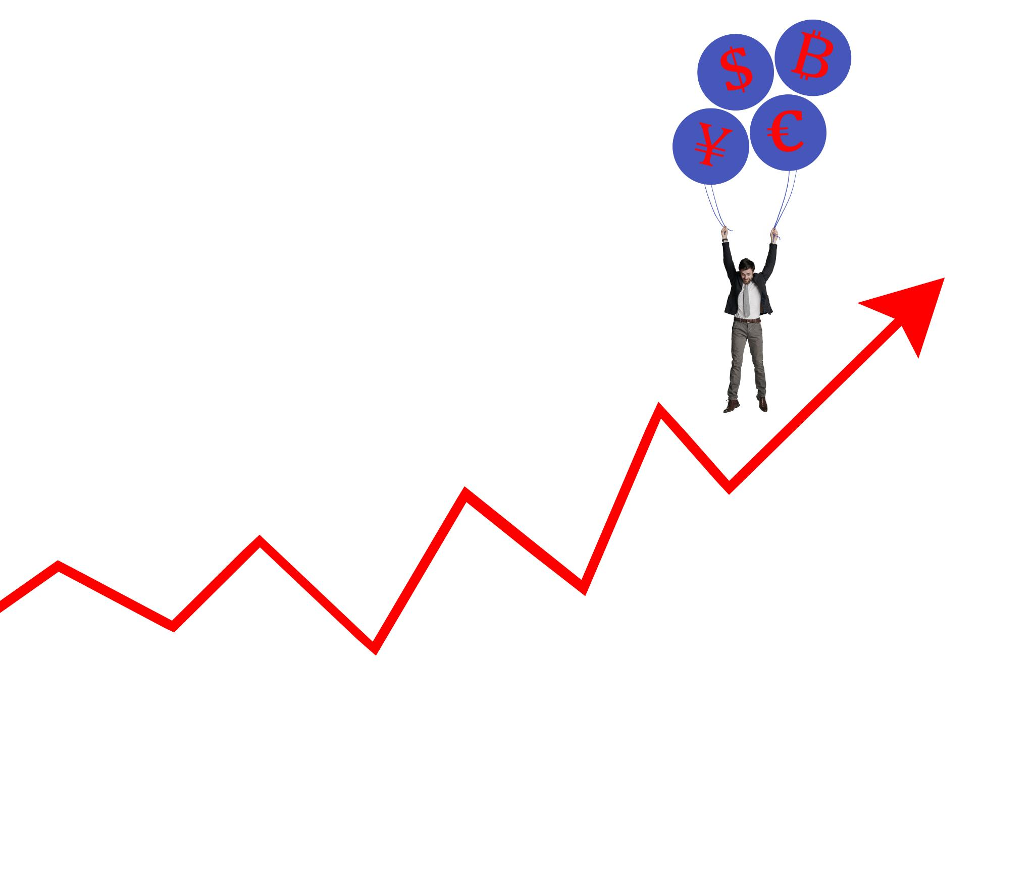
Importance of a Strategic Approach
Cohesive Launch Elements
A strategic approach ensures that all components of a product launch work together seamlessly for maximum impact.
Effective Resource Allocation
Strategic marketing helps organizations allocate their resources efficiently, optimizing budget and time for better results.
Risk Reduction
By following a strategic approach, organizations can identify potential risks early and mitigate them effectively.
Increased Success Rates
A well-defined strategy increases the likelihood of a successful product introduction and market acceptance.
Notes:
A strategic marketing approach ensures that all elements of the launch are aligned and cohesive. It helps organizations allocate resources effectively, reduce risks, and increase the chances of a successful product introduction.

Slide 6

Understanding the Market
Importance of Market Research
Conducting market research is essential for developing insights that inform effective marketing strategies.
Trends and Consumer Behavior
Understanding market trends and consumer behavior enables businesses to adapt their strategies and meet customer needs.
Competitive Analysis
Analyzing competitors helps identify strengths and weaknesses, guiding businesses in positioning themselves effectively in the market.
Notes:
Understanding the market is crucial in crafting a successful marketing strategy. This involves conducting research to gain insights into market trends, consumer behavior, and competitive analysis.

Slide 7

Conducting Market Research
Understanding Consumer Needs
Market research is essential for identifying consumer needs and preferences, enabling businesses to tailor their products accordingly.
Methods of Research
Utilize various methods such as surveys, focus groups, and interviews to gather valuable market data.
Data Analysis
Data analysis is a crucial step that helps interpret the gathered information and informs product development strategies.
Notes:
Market research helps identify consumer needs and preferences. Utilize surveys, focus groups, and data analysis to gather information that will guide product development and marketing efforts.

Slide 8

Analyzing Competitors
Understanding Competitor Strategies
Analyzing competitors offers valuable insights into their strategies, which can inform your own business decisions.
Identifying Strengths and Weaknesses
Competitor analysis helps identify their strengths and weaknesses, allowing you to leverage this information for competitive advantage.
Market Gaps and Opportunities
Understanding the competition reveals gaps in the market that present opportunities for differentiation and innovation.
Notes:
Analyzing competitors provides insight into their strategies, strengths, and weaknesses. Understanding the competition helps to identify gaps in the market and opportunities for differentiation.

Slide 9

Target Audience Identification
Importance of Target Audience
Identifying the right target audience is crucial for creating effective marketing strategies that resonate with consumers.
Market Segmentation
Market segmentation involves dividing the market into distinct groups based on demographics, psychographics, and behaviors.
Tailoring Marketing Messages
Tailoring marketing messages to specific audience segments ensures higher engagement and conversion rates.
Notes:
Identifying the right target audience is essential for effective marketing. This involves segmenting the market based on demographics, psychographics, and behaviors to tailor marketing messages.

Slide 10

Defining Customer Personas
Understanding Customer Segments
Creating customer personas allows marketers to understand the distinct motivations and preferences of various customer segments.
Enhancing Marketing Strategy
By understanding customer personas, marketing strategies can be tailored to resonate more effectively with the intended audience.
Notes:
Creating customer personas helps in understanding the motivations and preferences of different segments. This ensures that the marketing strategy resonates with the intended audience.

Slide 11

Segmenting the Target Market
Understanding Audience Diversity
Segmenting involves recognizing the diversity within the audience, which helps tailor marketing strategies.
Targeted Marketing Strategies
Creating targeted marketing efforts based on segmented groups can enhance customer engagement and improve conversion rates.
Higher Engagement Rates
By focusing on specific segments, marketers can achieve higher engagement levels through tailored messaging and offers.
Notes:
Segmenting the target market involves dividing the audience into distinct groups that share similar characteristics. This allows for targeted marketing efforts that can lead to higher engagement and conversion rates.

Slide 12

The Marketing Mix
Product
The 'Product' element focuses on what you are selling, including its features, benefits, and quality.
Price
The 'Price' component involves determining how much to charge for the product, considering costs and market demand.
Place
The 'Place' aspect addresses how the product will be distributed and made available to customers.
Promotion
The 'Promotion' element involves communicating with potential customers about the product and persuading them to buy.
Notes:
The marketing mix, often referred to as the 4Ps (Product, Price, Place, Promotion), encompasses all aspects of how the product will be marketed and sold. Each element must be carefully planned to ensure a cohesive strategy.

Slide 13

Product Strategy
Unique Features and Benefits
Identifying unique features and benefits is essential for differentiating the product in a competitive market.
Customer Needs
Understanding customer needs is crucial for developing a product that resonates with the target audience and meets their demands.
Packaging and Branding
Effective packaging and branding strategies are vital for attracting customers and enhancing the product's market appeal.
Notes:
Define the product's unique features and benefits. Ensure that it meets customer needs and stands out in the marketplace. Packaging and branding also play a crucial role in product strategy.

Slide 14

Pricing Strategy
Value Reflection
A successful pricing strategy must reflect the true value of the product to attract customers and build trust.
Cost Considerations
Understanding production costs is essential to setting prices that ensure profitability while remaining attractive to consumers.
Market Demand
Analyze market demand to adjust pricing strategies, ensuring competitiveness while meeting customer needs.
Customer Willingness to Pay
Gauge customer willingness to pay through surveys and market studies to inform pricing decisions effectively.
Notes:
Establish a pricing strategy that reflects the product's value while remaining competitive. Consider factors such as production costs, market demand, and customer willingness to pay.

Slide 15

Distribution Strategy
Distribution Channels Overview
Identify the distribution channels for your product, such as online platforms, retail stores, and direct sales.
Online Platforms
Utilize online platforms for product distribution to reach a wider audience and increase sales potential.
Retail Store Presence
Having a presence in retail stores can enhance product visibility and accessibility for customers.
Direct Sales Approach
Consider a direct sales approach to build stronger relationships with customers and gather valuable feedback.
Notes:
Plan how the product will be distributed to customers. Consider various channels, including online platforms, retail stores, and direct sales. Effective distribution is key to product availability.

Slide 16

Promotion Strategy
Advertising Techniques
Incorporate various advertising techniques to reach a broader audience and build brand recognition.
Public Relations Efforts
Utilize public relations to establish a positive image and manage communications around the new product.
Social Media Engagement
Leverage social media platforms to create buzz and directly engage with potential customers.
Sales Promotions
Implement sales promotions to encourage immediate purchase and create excitement around the product launch.
Notes:
Develop a promotion strategy that incorporates advertising, public relations, social media, and sales promotions. The goal is to create awareness and excitement around the new product.

Slide 17

Measuring Success
Importance of KPIs
Key performance indicators (KPIs) are essential for assessing the success of a product launch and overall performance.
Marketing Strategy Effectiveness
Evaluating the effectiveness of the marketing strategy enables businesses to identify strengths and areas for enhancement.
Continuous Improvement
Measuring success allows for continuous improvement in processes, strategies, and products based on data-driven insights.
Notes:
After the product launch, it is crucial to measure success through key performance indicators (KPIs). Evaluating the effectiveness of the marketing strategy helps identify areas for improvement.

Slide 18
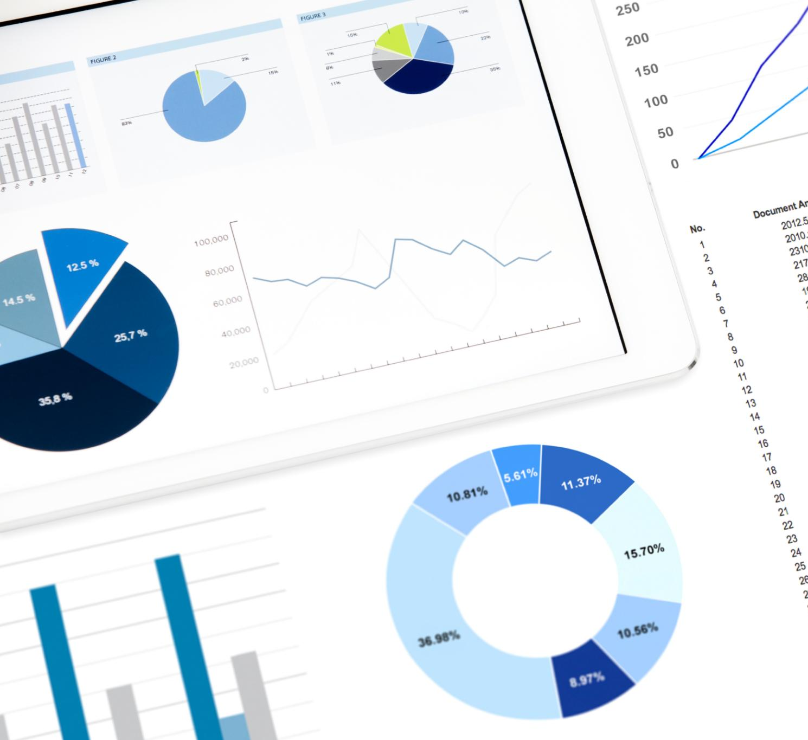
Setting KPIs
Sales Figures
Sales figures are critical KPIs that measure the revenue generated from the product launch and its market acceptance.
Customer Feedback
Customer feedback is vital for understanding user satisfaction and areas of improvement for the product.
Market Share
Market share indicates the product's position in the marketplace, reflecting its competitiveness and success.
Engagement Metrics
Engagement metrics help assess how actively customers interact with the product, influencing its long-term success.
Notes:
Establish clear KPIs to track the performance of the product launch. These may include sales figures, customer feedback, market share, and engagement metrics.

Slide 19

Analyzing Results
KPI Evaluation
Evaluating the launch results against established KPIs helps identify strengths and weaknesses in the product strategy.
Insights Generation
The analysis will generate valuable insights that inform future marketing strategies and facilitate improved decision-making.
Future Strategy Shaping
Understanding what worked and what didn’t allows for effective adjustments to future marketing approaches.
Notes:
Analyze the results of the product launch against the established KPIs. This analysis will provide insights into what worked and what didn’t, shaping future marketing strategies.

Slide 20
Conclusion
Comprehensive Marketing Strategy
A successful product launch relies on a well-rounded marketing strategy that encompasses market analysis and strategic planning.
Target Audience Understanding
Identifying and understanding the target audience is essential for creating effective marketing messages that resonate with potential customers.
Measuring Success
Measuring the success of a product launch allows businesses to refine their marketing strategies for future endeavors based on gathered insights.
Notes:
Launching a new product successfully requires a comprehensive marketing strategy that addresses market understanding, audience targeting, and the marketing mix. By measuring success, businesses can refine their strategies for future launches.

